Slide 1


MS-Applied Computer Science Chatbot Project
Under the Guidance of
Instructor : prof. Dr. Mark Chai
Client : prof. Dr. Ajay Bandi
PRESENTED BY:
Hemanth Sai Kagitha
Manasa Akula
Trinadh Machanavazzala
Mahesh Kollipara
Teja Reddy Dasari
Praveen Chidipothu

Slide 2
PROJECT OUTLINE
Objective: Improve information and support for prospective students, current students, and alumni through an advanced chatbot.
Key Features: AI-powered chatbot, personalized responses, support for course registration and alumni engagement.
Technology: Utilizes AI and NLP, integrates with databases, and offers a user-friendly interface.
Impact: Enhances engagement, fosters a supportive community, and improves the overall academic experience

Slide 3
INTRODUCTION
Launching "MS-Applied Computer Science Chatbot Project" to enhance the academic journey.
Smart chatbot powered by AI utilizing natural language processing and machine learning.
Serving prospective students with valuable insights, supporting current students with tasks, and keeping alumni connected.
Emphasis on creating a user-centric experience that empowers and enriches the academic experiences of all stakeholders.
Focus on building a supportive community to boost engagement and simplify communication.

Slide 4
PROBLEM STATEMENT
The academic journey for prospective students, current students, and alumni of the MS-Applied Computer Science program faces several challenges:
Accessibility Challenges: Some users, including students and prospects, struggle to access the website, hindering information retrieval.
Lack of Personalization: The website lacks personalization, making it difficult for users to find tailored information.
Irregular Updates: Information is inconsistently updated, causing uncertainty and eroding trust.
Complex Application Process: The enrollment process is complex, contributing to student frustration and effort.
Communication Inefficiency: Current course websites have inefficient communication methods, leading to delays in administrative responses and decreased satisfaction.

Slide 5
PROPOSED SOLUTION
Introducing a chatbot on our course website can:
Automate workflows, reducing repetitive tasks for employees.
Provide quicker responses, benefiting students and reducing the workload for administrative personnel.
Offer accessible features, tailored information.
Simplify the enrollment process, enhancing the overall user experience.

Slide 6
FUNCTIONAL REQUIREMENTS
Natural Language Understanding: The chatbot should be able to understand and make sense of how users naturally talk or write, whether they're typing messages.
User Input Handling: The chatbot must process and handle user queries, requests, and commands effectively.
Response Generation: The chatbot must generate contextually relevant and accurate responses to user queries.
Intent Recognition: The chatbot must recognize user intents to determine the user's purpose or request.
Information Retrieval: The chatbot must retrieve information from databases, APIs, or external sources as needed to provide answers and services.
Error Handling: The chatbot shall handle errors, exceptions, and unexpected user inputs, providing clear error messages and suggestions.

Slide 7
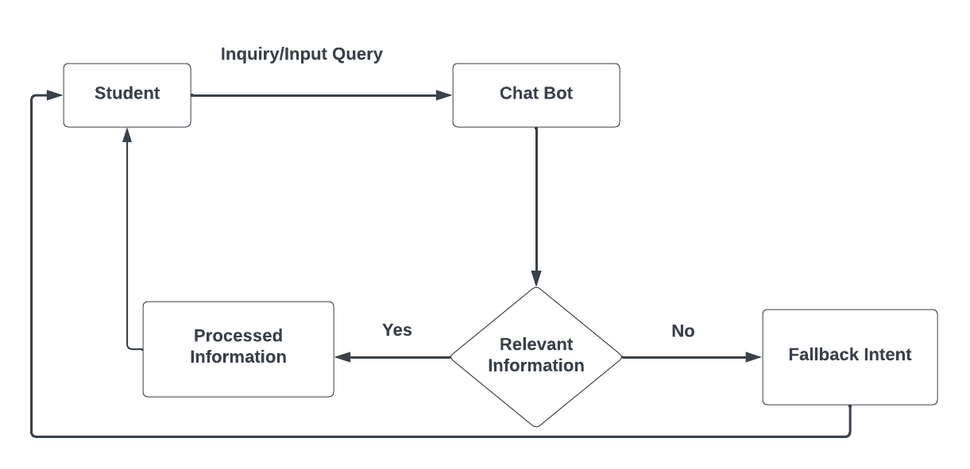
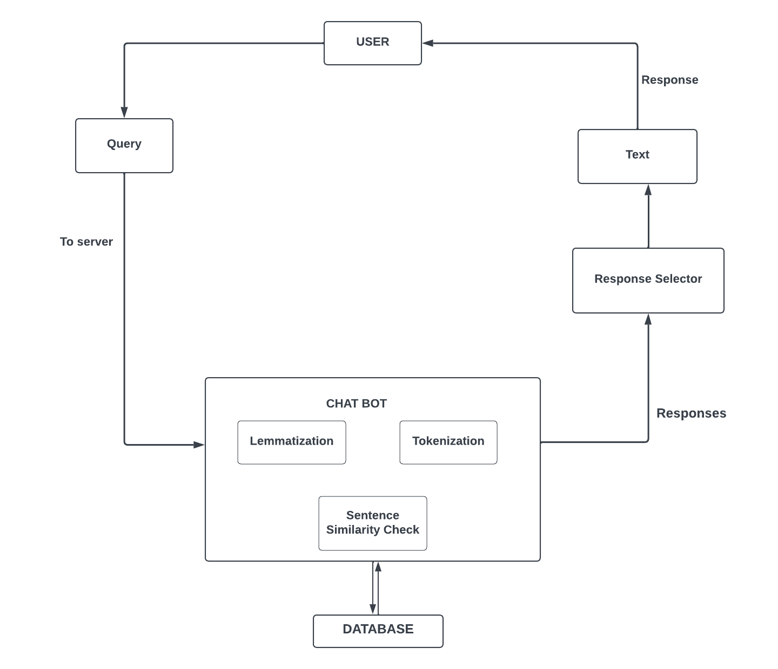
USER CASE DIAGRAM
ARCHITECTURE

Slide 8
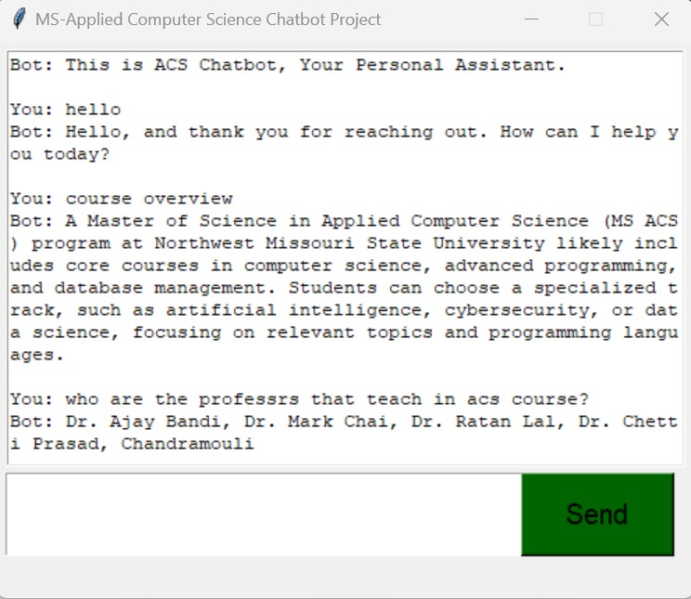
DEMO OF THE CHAT BOT
In this slide, we showcase an example interaction with the ACS Chatbot. The user initiates a conversation. The chatbot responds with relevant information in a conversational manner.
This visualization helps the audience understand how users interact with the chatbot to obtain information, making it an engaging and informative.

Slide 9
Accomplishments:
Functional Chatbot: Successfully developed a functional chatbot that can understand user queries and provide relevant responses.
User Interface Design: Created a user-friendly interface for the chatbot, making it easy for users to interact with and receive information.
Natural Language Processing (NLP): The chatbot demonstrates NLP capabilities by understanding and responding to natural language inputs from users.
Lessons Learned:
User-Centric Design: Understanding user needs and preferences is crucial. User-centric design principles have likely played a significant role in shaping the chatbot's functionality and interface.
Iterative Development: Software development involves repeatedly improving the chatbot based on user feedback and changing needs.
Team Collaboration: Effective collaboration within the project team, including developers, designers, and domain experts, is crucial for success.

Slide 10

Thank You!

